Slide 1

Understanding Key Factors That Influence Salary
Presented By : Near Lambardawati
Final Project – Data Scientist & Analyst Bootcamp 2025

Slide 2
TABLE OF CONTENT
INTRODUCTION
PROJECT STATEMENT
OBJECTIVE OF STUDY
DATA PREPATION
EXPLORATORY DATA ANALYSIS
MACHINE LEARNING
FINAL ACTION PLAN

Slide 3
INTRODUCTION
NEAR LAMBARDAWATI
DIBIMBING.ID (MAY – NOV 2025)
  DATA SCIENCE BOOTCAMP BATCH 34+
  (FOCUS ON PYTHON, SQL, POWER BI, TABLEAU , MACHINE LEARNING
PERBANAS UNIVERSITY (2019-2021)
  BACHELOR’S DEGREE IN ACCOUNTANCY
UNIVERSITAS PADJAJARAN (2012-2015)
  DIPLOMA 3 ADM. PERPAJAKAN
LINKED IN : www.linkedin.com/in/near-lambardawati-b23359186
GITHUB : HERE
STREAMLIT : HERE
As SPV OPS SUPPORT in PT. ERAJAYA SWASEMBADA

Slide 4
PROJECT STATEMENT
Why is Salary Analysis Important?
Many companies struggle to determine a fair salary range.
Candidates with similar experience may have different salaries depending on their position, education, and gender.
HR needs a data-driven approach, not just intuition.

Slide 5
objective
Identifying the key factors that influence salary (experience, education, job title, gender).
Helping HR understand the relationship between these variables.
Building a data-driven salary prediction model.

Slide 6
Data preparation
DATA SET SUMMARIES
6,704 rows and 6 columns
3 numerical features and 3 categorical features
4,911 duplicate rows detected
→ Duplicates removed to ensure data quality
No missing values found
Outliers identified and handled
→ No data removed during outlier treatment
Category “Other” standardized using mean encoding
→ Ensures no “Other” category remains in Gender
Job Title and Education Level standardized
→ To ensure consistent category naming
FEATURE GROUP
To better understand the factors that influence salary, organized the dataset into several feature groups.
Demographic Features
→ Age & Gender
Professional / Career Features
→ Years of Experience & Job Title
Education Features
→ Education Level
Target Variable
→ Salary

Slide 7
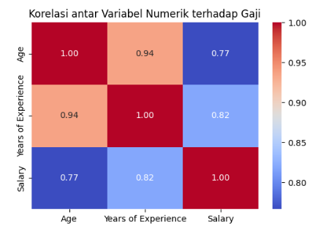
KEY FACTOR INFLUENCE SALARY?
Strong positive correlations show that work experience is the key driver of salary.
Age correlates with salary largely because it aligns with years of experience.
Therefore, experience should be prioritized in salary analysis and modeling, rather than age, to maintain fairness and avoid bias.

Slide 8
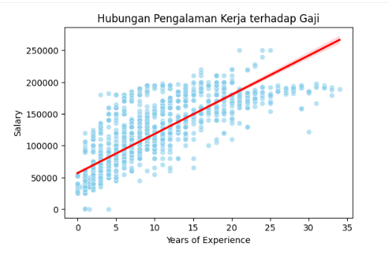
KEY FACTOR INFLUENCE SALARY?
Experience strongly correlates with salary growth.
Employees with more years of experience tend to earn significantly higher salaries.
The upward trend indicates:
Experience is a key driver of compensation
Salary increases steadily with accumulated expertise
Career progression and learning over time are rewarded in the market
Key takeaway: Work experience is a major determinant of salary.

Slide 9
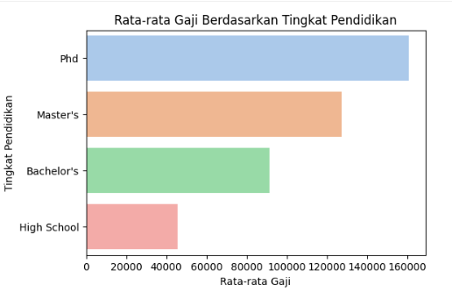
KEY FACTOR INFLUENCE SALARY?
Higher education leads to higher salary levels.
Employees with advanced degrees earn significantly more than those with only high school or bachelor's degrees.
Key observations:
PhD holders receive the highest average salaries
Master’s graduates earn more than bachelor’s
High school level has the lowest earning range

Slide 10
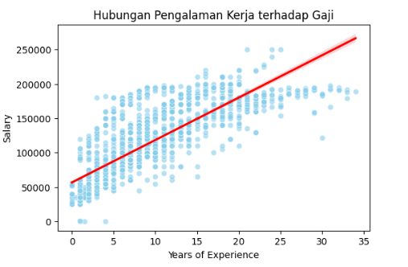
Relationship with the variables
This chart shows a clear positive relationship between work experience and salary.
As years of experience increase, salary tends to rise consistently.
Although there is some variation at each experience level, the overall upward trend indicates that experience plays a significant role in salary growth.
Key takeaway: Employees with more experience typically earn higher salaries.

Slide 11
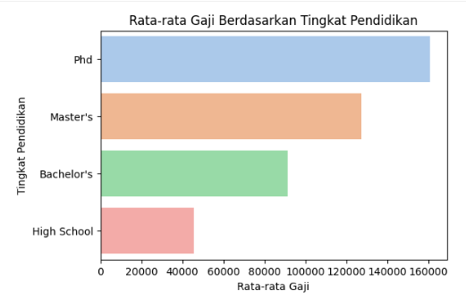
Relationship with the variables
This chart shows that higher education levels are associated with higher salaries.
Employees with PhD degrees earn the highest average salary, followed by Master’s, Bachelor’s, and High School graduates.
Key takeaway: Higher education correlates with higher earnings.

Slide 12
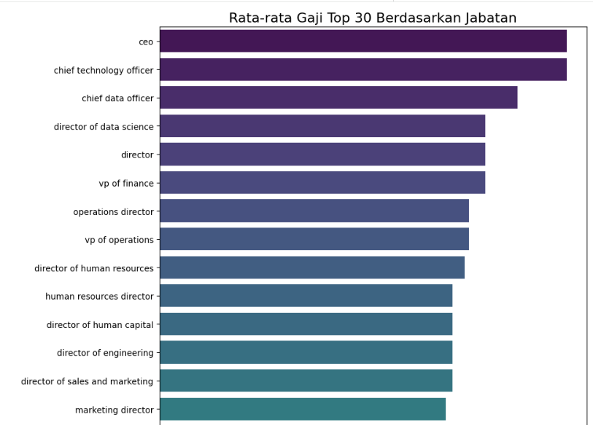
Relationship with the variables
The horizontal bar chart shows the Average Salary of the Top 30 Job Titles.
Consistently, the highest executive-level roles such as CEO, Chief Technology Officer, and Chief Data Officer have the highest average salaries.
Key takeaway: The higher the level of responsibility and the hierarchy of the job title, the greater the average salary.

Slide 13
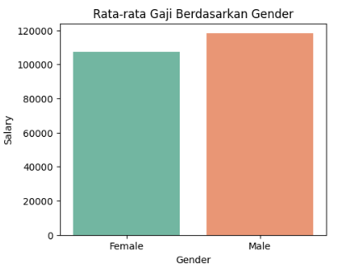
Relationship with the variables
We can clearly see a comparison of the average salaries between Female and Male employees here.
Male: The average salary appears to be higher, sitting close to $120,000.
Female: The average salary is lower, positioned around $108,000.
The Main Takeaway: Based purely on this data, there seems to be a salary gap present. The average male salary in this dataset is higher than the average female salary.

Slide 14
DATA PREPRoCESSING
DATA PRE- PROCESSING
Handling Duplicated
FEATURE SELECTION & ENGINEERING
Standardization numerical variable
& Checking Multiollinearity
SPLIT DATA
80% Train : 20% Split
OUTLING HANDLING
IQR Method

Slide 15
MULTICOLINEARITY
REDUNDANT VARIALE
AGE
YEARS OF EXPERIENCE
DROP COLUMN :
AGE

Slide 16
Regression model the best model
Model | Train MAE | Test MAE | Train MAPE | Test MAPE | Train RMSE | Test MAP | Train R2 | Train R2
Ridge | 14351.20 | 15103.83 | 19780.21 | 2OO30.70 | 43.94 | 14.27 | 0.85 | 0.84
Lasso | 14304.85 | 15165.66 | 19777.47 | 20079.86 | 43.71 | 14.41 | 0.85 | 0.84
Random Forest | 5941.82 | 10584.98 | 10042.39 | 16043.80 | 29.27 | 9.97 | 0.96 | 0.90
Based on all metrics, especially the superior $R^2$ (0.90) and the lowest MAE ($10,585),
the Random Forest Regressor is the best model for salary prediction.
Although there is a slight degree of overfitting, the overall accuracy and
predictive power of the Random Forest model significantly exceeds that of the Ridge and Lasso models.

Slide 17
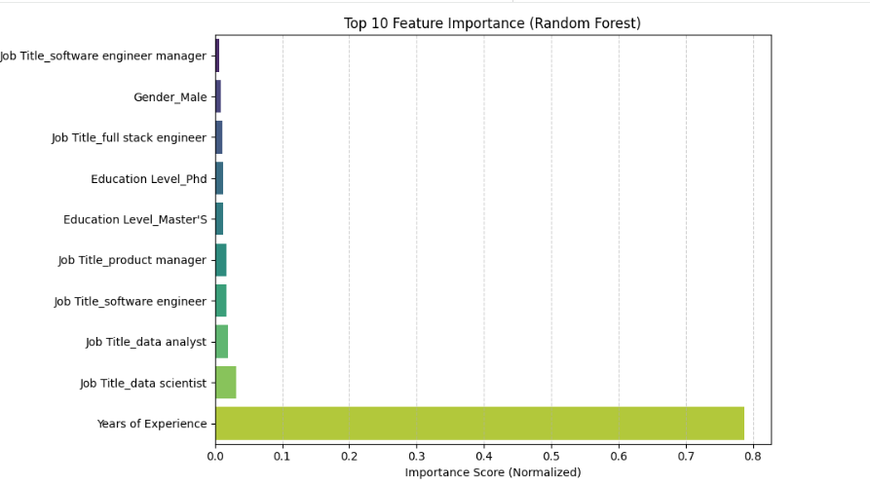
Feature importance
The Years of Experience factor is highly dominant and far more important than any other variable, achieving an importance score of nearly 0.8 (or 80% of the total distributed importance).
Key Takeaway: This confirms our intuitive finding that seniority and time spent in the job role are the primary determinants of salary size. Companies place the highest value on cumulative experience.

Slide 18
Recomendation

